Slide 1
Budget Factors
GCCCD Governing Board Meeting – January 2017

Slide 2
Learning Objective
To introduce and refresh understanding of general factors that affect budget development and decisions

Slide 3
Overview
Faculty Obligation Number (FON)
Lorenze Legaspi
Full Time Equivalent Student (FTES)
Sahar Abushaban
PERS/STRS Increases
Doug Jenson
Governor’s January Budget
Doug Jenson

Slide 4
Faculty Obligation Number

Slide 5
Faculty Obligation Number (FON)
Who/what/where/when/how?

Slide 6
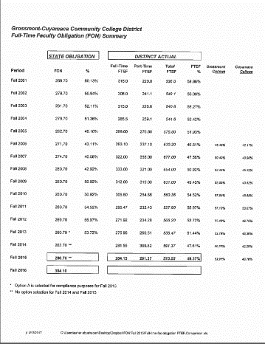
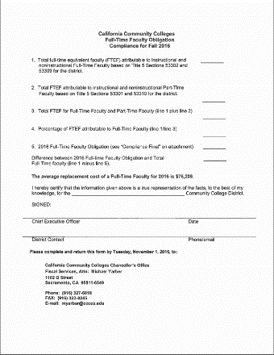
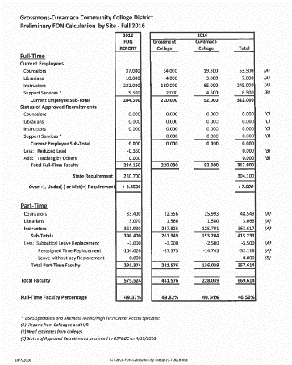
FON
What – FON sets the minimum number of Full-Time Faculty (FTF)
Who – Tenure Track
Where – Calculated as a district
When – Established in 1988 based on 88/89 number of FTF
How – FON is increased with growth in credit FTES

Slide 7
FON at GCCCD
2016/17 Obligation – 304 FTF
Grossmont College 220.0
Cuyamaca College +87.5
Total GCCCD 307.5 FTF

Slide 8
The Basics of FTES

Slide 9
WHAT IS FTES?
Full-Time Equivalent Student
It is not a headcount
One FTES is equivalent to 525 hours of student instruction
Can be generated by one student or multiple part-time students

Slide 10
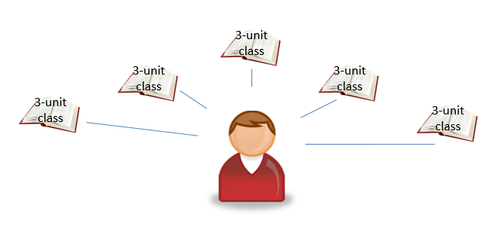
FTES Calculation
Fall
Spring
Mike
5 classes x 3 hours x 35 weeks = 525 Instruction Hours

Slide 11
FTES Calculation
Fall
Debbie
Barbara
Larry
9 hours
Microbiology
Lecture & lab
+
3 hours
Economics
+
3 hours
Algebra
=
15 Hours per week

Slide 12
FTES Calculation
Spring
Debbie
Barbara
Larry
5 hours
Math
+
3 hours
English
+
7 hours
History & Music
=
15 Hours per week
15 hours X 35 Weeks = 525 Instruction Hours

Slide 13
FTES Calculation
Nonresident FTES
Title V-58003.4
Approved Courses
Census Day
Weekly Census
Resident FTES
Positive attendance
Daily Student Contact Hour
Census Roster
Daily Census
Summer Shift rules
Special Admit PE limit
Audit
Course Repetition
Instructional days
Basic Skills
Independent Study (Distance Education)
Weekly Student Contact Hour
Open Entry/Open Exit
Approved Courses
Term Length Multiplier
AB 540 students
Open Enrollment
Credit vs. Noncredi
Credit vs. Noncredit

Slide 14
Why Is FTES Important?
85% of District Unrestricted General Funds come from earning FTES
2016-2017
$95.4 million out of $122 million
19,075 FTES
State only funds District for resident FTES

Slide 15
How Is FTES Funded?
Credit FTES = $5,004/FTES
Noncredit FTES = $3,009/FTES

Slide 16
How Is FTES Reported?
Apportionment Attendance Report (CCFS -320)
Filed to the State Chancellor’s Office
Reporting Periods
First Period (P1)
Second Period (P2)
Annual Report
Recalc Report

Slide 17
Timeline
2016-2017
2015-2016
2017-2018

Slide 18
Summary
District has to earn the FTES to receive the funds
Close monitoring throughout the year
Critical decisions to be made
Complicated to calculate

Slide 19
STRS & PERS

Slide 20
What Is STRS & PERS
CalSTRS = State Teachers’ Retirement System
Provides retirement, disability and survivor benefits for California’s Pre-Kindergarten – Community College educators and their families (largest teachers’ retirement fund in the U.S.)
CalPERS = Public Employees’ Retirement System
Manages pension and health benefits for California public employees, retirees, and their families (largest public pension fund in the U.S.)

Slide 21
STRS
 | 2014/15 | 2020/21 | INCREASE
 | Actual | Estimate
Rate | 11.77% | 20.40% | 73.30%

Slide 22
PERS
 | 2014/15 | 2020/21 | INCREASE
 | Actual | Estimate
Rate | 8.88% | 19.10% | 115.1%

Slide 23
Estimated STRS & PERS
Increase
6 year increase = ~ $32.5 M
Based on current employees

Slide 24
Governor’s January Budget

Slide 25
Governor Brown’s 17-18 January Budget Proposal Message
The Governor urged state leaders to set aside funding against future volatility, and dedicated the budget to his late first dog Sutter, and included the quote “Save some biscuits for a rainy day”.
The CCC Chancellor’s Office commented that state revenues are now beginning to lag expectations, and that years of seeing significant increases are likely behind us. Colleges should expect modest growth until the next recession.
Chancellor Miles followed up the Governor’s message by saying “we will remain fiscally conservative and keep up our budget reserves to protect our fiscal security.”

